Slide 1

Chapter 3
Cloud | Architecture Framework
TS&A Enterprise Architecture
V 1.0 | March 2022
Notes:
Changes Required:
Industry Name
Industry Picture

Slide 2
Document control & contacts
Internal material only. Not to be sent to clients
Executive Sponsors
ETB Program Advisors
Cloud ETB Lead
SME Panel
Koenraad Schelfaut
Tech Strategy and Advisory – Global Lead
James Burrows
Industry - Network Lead
Andrew Long
Enterprise Architecture Strategy – Global Lead
Executive Review Board
Giuliano Benincasa
Technology Strategy & Advisory
Andrew Long
Enterprise Architecture Strategy – Global Lead
Thomas Snelgrove
Senior Manager – Technology Strategy & Advisory
Arijit Ghoshal
Senior Manager – Technology Strategy & Advisory
ETB Team
Shaalin Nathwani
Consultant – Technology Strategy & Advisory
Samuel.J.Gunn
Yuriy.Skopets
Graham.C.Paul
Louise.Moggach
ETB Program Team
Giuliano Benincasa
Enterprise Technology Blueprints Lead
Devyani Anil Atkar
ETB Program Manager
Version: 1.0, March 2022

Slide 3



Introducing Enterprise Technology Blueprints
Internal material only. Not to be sent to clients
What are ETBs?
Why do we need ETBs?
Technology Strategy & Advisory partners with the Industry teams to develop industry specific Enterprise Technology Blueprints (ETBs) for many key industries.
ETBs are structured frameworks that provide a holistic view of all necessary technology capabilities that enable a Cloud business.
ETBs also include technology trends, vendor and product information and architecture principles.
ETBs combine enterprise architecture expertise with industry and functional knowledge across clients and geographies.
The purpose of the ETB is to:
Capture latest technology thought leadership in Cloud enterprise architecture
Demonstrate Accenture’s Cloud enterprise architecture expertise
Accelerate technology strategy projects
This is the 1st version of the “Cloud Enterprise Technology Blueprint”. ​
Enterprise Technology Blueprint
Notes:
Changes Required:
Enter industry

Slide 4
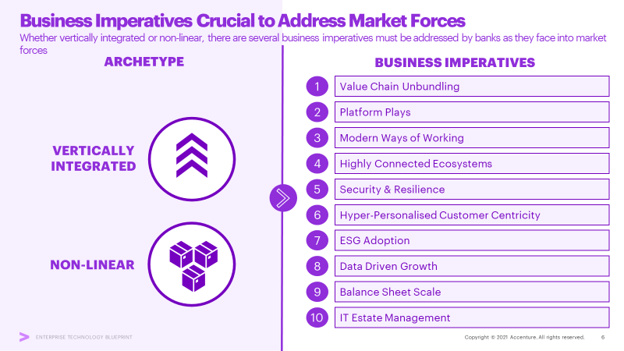
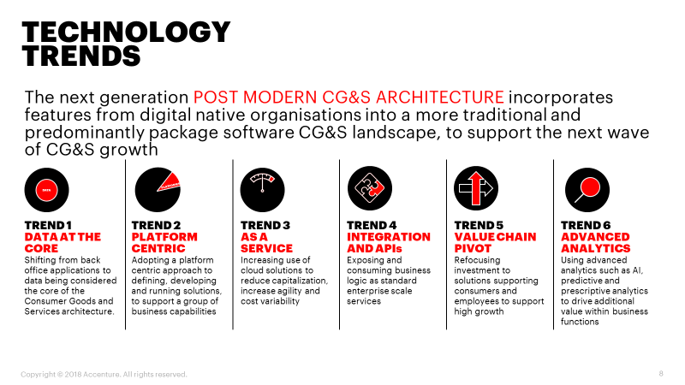
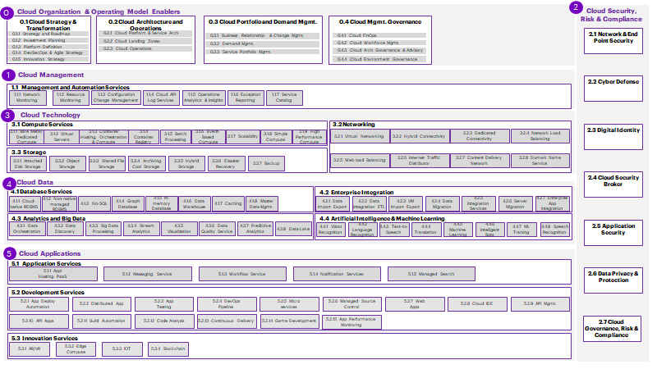
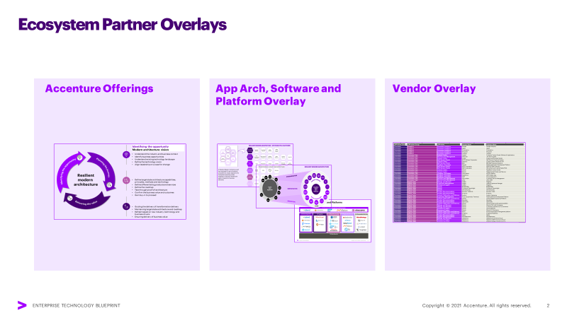
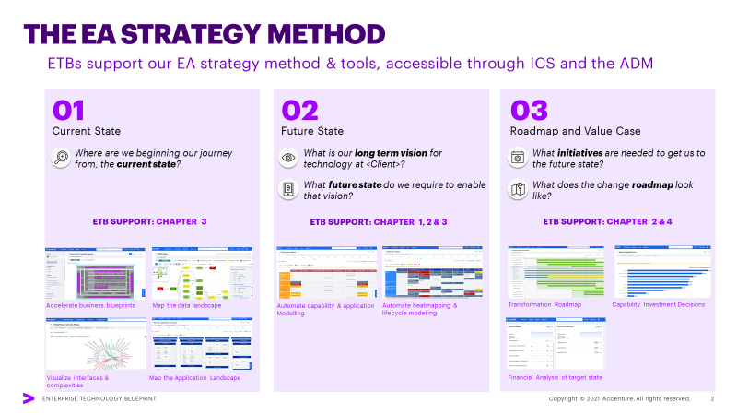
What is in the Cloud Enterprise Technology Blueprint v1.0?
Internal material only. Not to be sent to clients
CHAPTER 1
CHAPTER 2
CHAPTER 3
*CHAPTER 4
*CHAPTER 5
NEW IT
CIO AGENDA
TECHNOLOGY TRENDS
ARCHITECTURE FRAMEWORK & PRINCIPLES
ECOSYSTEM OVERLAY
ACCENTURE OVERLAY
Overview of latest Industry Context, Resilient Modern Architecture, Approach and Case Studies to help shape the discussions with the client on enabling digital business with modern architecture
Deep dive on Technology Trends, implication on Application Architecture and Data/ Analytics trends shaping how organisations are driving drive business value
Refreshed Architecture Framework, Data Architecture to support data driven enterprises and extension into non-traditional capabilities to support new business models. Set of architectural principles to guide practitioners.
An overlay of Accenture’s ecosystem partners to the industry/functional/ technical reference architecture campaigns, offerings, and assets.
An overlay of Accenture’s internal tools that support transformational solutions for clients mapped to the capabilities in the model.
*Optional Chapters
Notes:
Changes Required:
Enter industry

Slide 5

Contents
01.
Logical Reference Architecture
02.
Market Leading Software and Platforms
Copyright © 2022 Accenture. All rights reserved.
5

Slide 6

Logical Application Architecture
01.
Notes:
No Changes

Slide 7
2
0
Cloud Organization & Operating Model Enablers
Cloud Security, Risk & Compliance
0.1 Cloud Strategy & Transformation
0.2 Cloud Architecture and Operations
0.3 Cloud Portfolio and Demand Mgmt.
0.4 Cloud Mgmt. Governance
0.1.1 Strategy and Roadmap
0.2.1 Cloud Platform & Service Arch
0.3.1 Business Relationship & Change Mgmt.
0.4.1 Cloud FinOps
2.1 Network & End Point Security
0.1.2 Investment Planning
0.2.2 Cloud Landing Zones
0.3.2 Demand Mgmt.
0.4.2 Cloud Workforce Mgmt.
0.1.3 Platform Definition
0.2.3 Cloud Operations
0.3.3 Service Portfolio Mgmt.
0.4.3 Cloud Arch Governance & Advisory
0.1.4 DevSecOps & Agile Strategy
0.4.4 Cloud Environment Governance
0.1.5 Innovation Strategy
1
Cloud Management
1.1 Management and Automation Services
2.2 Cyber Defense
1.1.1 Network Monitoring
1.1.2 Resource Monitoring
1.1.3 Configuration Change Management
1.1.4 Cloud API Log Services
1.1.5 Operations Analytics & Insights
1.1.6 Exception Reporting
1.1.7 Service Catalog
3
Cloud Technology
3.1 Compute Services
3.2 Networking
2.3 Digital Identity
3.1.1 Bare Metal/ Dedicated Compute
3.1.2 Virtual Servers
3.1.3 Container Hosting, Orchestration & Compute
3.1.4 Container Registry
3.1.5 Batch Processing
3.1.6 Event-Based Compute
3.1.7 Scalability
3.1.8 Simple Compute
3.1.9 High Performance Compute
3.2.1 Virtual Networking
3.2.2 Hybrid Connectivity
3.2.3 Dedicated Connectivity
3.2.4 Network Load Balancing
3.3 Storage
3.3.1 Attached Disk Storage
3.3.2 Object Storage
3.3.3 Shared File Storage
3.3.4 Archiving Cool Storage
3.3.5 Hybrid Storage
3.3.6 Disaster Recovery
3.3.7 Backup
3.2.5 Web load Balancing
3.2.6 Internet Traffic Distributor
3.2.7 Content Delivery Network
3.2.8 Domain Name Service
Cloud Data
2.4 Cloud Security Broker
4
4.1 Database Services
4.2 Enterprise Integration
4.1.1 Cloud-native RDBMS
4.1.2 Non-native
managed RDBMS
4.1.3 No-SQL
4.1.4 Graph Database
4.1.5 In-memory Database
4.1.6 Data Warehouse
4.1.7 Caching
4.1.8 Master
Data Mgmt.
4.2.1 Data Import Export
4.2.2 Data Integration ETL
4.2.3 VM Import Export
4.2.4 Data Migration
4.2.5 Integration Services
4.2.6 Server Migration
4.2.7 Enterprise App
Integration
4.3 Analytics and Big Data
4.4 Artificial Intelligence & Machine Learning
2.5 Application Security
4.3.1 Data Orchestration
4.3.2 Data Discovery
4.3.3 Big Data Processing
4.3.4 Stream Analytics
4.3.5 Visualization
4.3.6 Data Quality Service
4.3.7 Predictive Analytics
4.3.8 Data Lake
4.4.1 Vision Recognition
4.4.2 Language Recognition
4.4.3 Text-to-Speech
4.4.4 Translation
4.4.5 Machine Learning
4.4.6 Intelligent Bots
4.4.7 ML Training
4.4.8 Speech Recognition
5
Cloud Applications
5.1 Application Services
5.1.1 Appl
Hosting PaaS
5.1.2 Messaging Service
5.1.3 Workflow Service
5.1.4 Notification Services
5.1.5 Managed Search
2.6 Data Privacy & Protection
5.2 Development Services
5.2.1 App Deploy Automation
5.2.2 Distributed App
5.2.3 App
Testing
5.2.4 DevOps
Pipeline
5.2.5 Micro
services
5.2.6 Managed Source
Control
5.2.7 Web
Apps
5.2.8 Cloud IDE
5.2.9 API Mgmt.
5.2.10 API Apps
5.2.11 Build Automation
5.2.12 Code Analysis
5.2.13 Continuous Delivery
5.2.14 Game Development
5.2.15 App Performance Monitoring
2.7 Cloud Governance, Risk & Compliance
5.3 Innovation Services
5.3.1 AR/VR
5.3.2 Edge Compute
5.3.3 IOT
5.3.4 Blockchain

Slide 8
Business Capabilities Reference Architecture
0. Cloud Organization & Operating Model Enablers (1/4)
0.1 Cloud Strategy & Transformation
0.1.1 Strategy and Roadmap
0.1.2 Investment Planning
0.1.3 Platform Definition
0.1.4 DevSecOps & Agile Strategy
0.1.5 Innovation Strategy
Application Domain | Application Block | Description
0.1 Cloud Strategy & Transformation | 0.1.1 Strategy and Roadmap | Define, shape, and structure the overall cloud strategy (including considerations around cloud management platforms, cloud platform selection, hybrid and multi-cloud strategies, cloud exit strategies etc.). Design operating model, principles, and processes that are aligned to the required business outcomes; identify key initiatives and create roadmaps; perform gap analysis to inform a Target Operating Model; and communicate vision to stakeholders. Develop OKRs and monitor framework progress
 | 0.1.2 Investment Planning | Plan and prioritise cloud budget in alignment with strategic objectives, roadmap and value outcomes, considering planned offerings, past investment, demand pipeline and relevant implications
 | 0.1.3 Platform Definition | Initial scoping and design of core enterprise cloud platform for example administrative rights, Cloud Service Vetting Billing & metering process, Enterprise agreement, Account & platform Strategies etc.
 | 0.1.4 DevSecOps & Agile Strategy | Align with overall organisational strategies and frameworks (if any) around DevSecOps / Agile / CICD. Define the desired process and frameworks; establishing guardrails for end-to-end toolset; build a roadmap for implementation
 | 0.1.5 Innovation Strategy | Develop an Innovation Framework; research, identify and document new / existing cloud related technologies, processes and industry trends, and assess their impact of cloud trends on organisation; select potential innovation opportunities based on feasibility

Slide 9
Business Capabilities Reference Architecture
0. Cloud Organization & Operating Model Enablers (2/4)
0.2 Cloud Architecture and Operations
0.2.1 Cloud Platform & Service Arch
0.2.2 Cloud Landing Zones
0.2.3 Cloud Operations
Application Domain | Application Block | Description
0.2 Cloud Architecture and Operations
0.2 Cloud Architecture and Operations | 0.2.1 Cloud Platform & Service Arch | Define and design the Cloud platform architecture. Develop a set of artefacts and guardrails that will establish the architectural process and continuous development of a Platform & Service Architecture. Define and maintain the overall service architecture, develop service architecture blueprints, design, and roadmap for each service offering.
 | 0.2.2 Cloud Landing Zones | Using best practice, specify design and establish secure Cloud Landing Zone for the organization. Capture and ensure the organizational parameters are met. E.g. The security, data, PaaS, storage, networking, compute components. Test and ensure that the Landing Zone provides rapid and secure access to Cloud Services for its consumers.
 | 0.2.3 Cloud Operations | Establish Monitoring and management of financial and operational risks. Establish controls and tooling to monitor and manage operations. E.g. FinOps tooling, SaaS controls,

Slide 10
Business Capabilities Reference Architecture
0. Cloud Organization & Operating Model Enablers (3/4)
0.3 Cloud Portfolio and Demand Mgmt.
0.3.1 Business Relationship & Change Mgmt.
0.3.2 Demand Mgmt.
0.3.3 Service Portfolio Mgmt.
Application Domain | Application Block | Description
0.3 Cloud Portfolio and Demand Mgmt. | 0.3.1 Business Relationship & Change Mgmt. | Act as a single point of contact for the Cloud consumers, communicating cloud service offerings and benefits, partnering to identify gaps, areas for improvement, risks, and challenges, collecting formal and informal feedback. Ensure that proposed changes are controlled, monitored and implemented with minimal disruption to service delivery. Leverage automation for planning, tracking, and delivering planned changes as much as possible/practical. Detect and manage unauthorized changes.
 | 0.3.2 Demand Mgmt. | Proactively understand Cloud consumer demand (including future requirements and demand for new services not available currently), manage the demand pipeline, understand budget and investment implications and communicate new service requirements and enhancements to the Architecture and Services teams
 | 0.3.3 Service Portfolio Mgmt. | Deliver committed portfolio of services within agreed constraints, including service roadmaps, tracking usage, overseeing delivery, defining potential improvement opportunities and manage services through their end-to-end lifecycle, including deprecation of services.

Slide 11
Business Capabilities Reference Architecture
0. Cloud Organization & Operating Model Enablers (4/4)
0.4 Cloud Mgmt. Governance
0.4.1 Cloud FinOps
0.4.2 Cloud Workforce Mgmt.
0.4.3 Cloud Arch Governance & Advisory
0.4.4 Cloud Environment Governance
Application Domain | Application Block | Description
0.4 Cloud Mgmt. Governance | 0.4.1 Cloud FinOps | Shorthand for “Cloud Financial Operations” or “Cloud Financial Management” or “Cloud Cost Management”. Bringing financial accountability to the variable spend model of cloud, enabling distributed teams to make business trade-offs between speed, cost, and quality.
 | 0.4.2 Cloud Workforce Mgmt. | Map key workforce capabilities, roles, and responsibilities required for an efficiently functioning Cloud organisation; facilitate recruitment process; build cloud community; ensure appropriate compensation structure and rewards / recognitions are in place; establish performance management framework.
 | 0.4.3 Cloud Arch Governance & Advisory | Define and maintain Cloud architecture governance framework in line with overall organisational technology governance. Promote adherence to defined principles, designs, standards, policies, patterns. Provide guidance, best practices and advice to project teams / business units wanting to migrate their applications / workloads to the Cloud or build Cloud native applications.
 | 0.4.4 Cloud Environment Governance

Slide 12
Business Capabilities Reference Architecture
1. Cloud Management (1/1)
1.1 Management & Automation Services
1.1.1 Network Monitoring
1.1.2 Resource Monitoring
1.1.3 Configuration Change Mgmt.
1.1.4 Cloud API Log Service
1.1.5 Operations, Analytics & Insights
1.1.6 Exception Reporting
1.1.7 Service Catalog
Application Domain | Application Block | Description
1.1 Management & Automation Services | 1.1.1 Network Monitoring | Capture IP traffic information going to and from network interfaces
 | 1.1.2 Resource Monitoring | Tools for monitoring, tracking, and data collection of resources
 | 1.1.3 Configuration Change Mgmt. | Ability to assess, audit, and evaluate configurations
 | 1.1.4 Cloud API Log Service | Log and track user activity and API usage
 | 1.1.5 Operations, Analytics & Insights | Monitoring of applications and infrastructure
 | 1.1.6 Exception Reporting | Compliance, operational and risk auditing
 | 1.1.7 Service Catalog | Create and manage catalogs of approved IT services

Slide 13
Business Capabilities Reference Architecture
2. Cloud Security, Risk & Compliance
2.1 Network & End Point Security
2.2 Cyber Defense
2.3 Digital Identity
2.4 Cloud Security Broker
2.5 Application Security
2.6 Data Privacy & Protection
2.7 Cloud Governance, Risk & Compliance
Application Domain | Application Block | Description
2.Cloud Security, Risk & Compliance | 2.1 Network & End Point Security | Evaluation of Network security, firewalls and intrusion detection / prevention system.
 | 2.2 Cyber Defense | Prevent, detect and respond to cyber attacks and threats in order to protect the infrastructure and the information assets of an organization.
 | 2.3 Digital Identity | Assess and authenticate users and agents to protect and control access to data, systems, services, buildings and computers.
 | 2.4 Cloud Access Security Broker | Security policy enforcement points, placed as an intermediary between consumers and providers to enforce enterprise-standard security policies.
 | 2.5 Application Security | Ensure applications are secure by design; take into consideration DevSecOps, Microservices/API security, Application Firewalls and ongoing Security testing and monitoring.
 | 2.6 Data Privacy & Protection | Ability to discover, classify and protect the organization's data and privacy of individuals, through appropriate controls and data management techniques.
 | 2.7 Cloud Governance, Risk & Compliance | Management function to control Risk, Compliance, Security, Privacy and Protection with industry specific and organizational policies, procedures, standards and measures.

Slide 14
Business Capabilities Reference Architecture
3. Cloud Technology (1/3)
3.1 Compute Services
3.1.1 Bare Metal/ Dedicated Compute
3.1.2 Virtual Servers
3.1.3 Container Hosting, Orchestration & Compute
3.1.4 Container Registry
3.1.5 Batch Processing
3.1.6 Event-Based Compute
3.1.7 Scalability
3.1.8 Simple Compute
3.1.9 High Performance Compute
Application Domain | Application Block | Description
3.1 Compute Services | 3.1.1 Bare Metal/Dedicated Compute | Physical hardware that's dedicated to a single customer/tenant
 | 3.1.2 Virtual Servers | Virtualized machine instance with various configurations and OS options
 | 3.1.3 Container Hosting, Orchestration and Compute | Ability to create host and manage container images at scale.
 | 3.1.4 Container Registry | Library of Docker-formatted images used in container deployments
 | 3.1.5 Batch Processing | Orchestration of tasks and jobs across hundreds or thousands of nodes
 | 3.1.6 Event Based Compute | Aka “serverless” – event-driven, scalable and durable execution fabric
 | 3.1.7 Scalability | Adjusting the number of instances carrying the same workload
 | 3.1.8 Simple Compute | Lightweight, simplified, rapid server provisioning for non-techies
 | 3.1.9 High Performance Compute | Parallelising compute power in order to solve complex, resource intensive, problems in minimal time.

Slide 15
Business Capabilities Reference Architecture
3. Cloud Technology (2/3)
3.2 Networking
3.2.1 Virtual Networking
3.2.2 Hybrid Connectivity
3.2.3 Dedicated Connectivity
3.2.4 Network Load Balancing
3.2.5 Web Load Balancing
3.2.6 Internet Traffic Distributor
3.2.7 Content Delivery Network
3.2.8 Domain Name Service
Application Domain | Application Block | Description
3.2 Networking | 3.2.1 Virtual Networking | An isolated, private networking environment in the cloud
 | 3.2.2 Hybrid Connectivity | Connecting to other virtual or on-premises networks from the public cloud
 | 3.2.3 Dedicated Connectivity | A dedicated, private network connection to the cloud provider
 | 3.2.4 Network Load Balancing | Automatic distribution of IP traffic across a group of IP nodes
 | 3.2.5 Web Load Balancing | Automatic distribution of http/s traffic across a group of endpoints
 | 3.2.6 Internet Traffic Distributor | Distributes traffic to application endpoints and manages failover
 | 3.2.7 Content Delivery Network | Caches and transfers audio, video, applications, images, and other files
 | 3.2.8 Domain Name Service | Manage Domain Name Service records and resolves name requests

Slide 16
Business Capabilities Reference Architecture
3. Cloud Technology (3/3)
3.3 Storage
3.3.1 Attached Disk Storage
3.3.2 Object Storage
3.3.3 Shared File Storage
3.3.4 Archiving Cool Storage
3.3.5 Hybrid Storage
3.3.6 Disaster Recovery
3.3.7 Backup
Application Domain | Application Block | Description
3.3 Storage | 3.3.1 Attached Disk Storage | VM-attached storage optimized for I/O intensive read/write operations
 | 3.3.2 Object Storage | Secure, reliable and durable http/s-accessible object storage
 | 3.3.3 Shared File Storage | Shared file system accessible from multiple sources
 | 3.3.4 Archiving Cool Storage | Low-cost slow storage for infrequently accessed archived data
 | 3.3.5 Hybrid Storage | Integrated on-premises and cloud data storage
 | 3.3.6 Disaster Recovery | Automated protection and replication of environments with recovery plans
 | 3.3.7 Backup | Backup and archival solutions that allow files to be backed-up to the cloud

Slide 17
Business Capabilities Reference Architecture
4. Cloud Data (1/4)
4.1 Database Services
4.1.1 Cloud-native RDBMS
4.1.2 Non-native
managed RDBMS
4.1.3 No-SQL
4.1.4 Graph Database
4.1.5 In-memory Database
4.1.6 Data Warehouse
4.1.7 Caching
4.1.8 Master
Data
Mgmt.
Application Domain | Application Block | Description
4.1 Database Services | 4.1.1 Cloud native RDBMS | Cloud-native, highly performant, reliable, scalable and secure database engine
 | 4.1.2 Non-native managed RDBMS | Managed wrapper for RDBMS as a service
 | 4.1.3 No SQL | Read-optimized, non-relational database usually optimized for distribution and scale
 | 4.1.4 Graph Database | Multi node databased optimized for multiple joins
 | 4.1.5 In-memory database | An in-memory columnar database stores compressed data
 | 4.1.6 Data Warehouse | A very large and durable store of data from a wide range of sources
 | 4.1.7 Caching | An in-memory, distributed-caching that provides a fast non-durable store
 | 4.1.8 Master Data Mgmt. | An enterprise-wide metadata catalog that enables data discovery

Slide 18
Business Capabilities Reference Architecture
4. Cloud Data (2/4)
4.2 Enterprise Integration
4.2.1 Data Import Export
4.2.2 Data Integration ETL
4.2.3 VM Import Export
4.2.4 Data Migration
4.2.5 Integration Services
4.2.6 Server Migration
4.2.7 Enterprise App
Integration
Application Domain | Application Block | Description
4.2 Enterprise Integration | 4.2.1 Data Import Export | Data transfer to and from the cloud
 | 4.2.2 Data Integration ETL | Manage data between data stores
 | 4.2.3 VM Import Export | Services to support migration of on-prem servers to/from/within the cloud
 | 4.2.4 Data Migration | Services to support migration of databases to/from/within the cloud
 | 4.2.5 Integration Services | Scalable integrations and workflows in the cloud
 | 4.2.6 Server Migration | Services to support migration of servers to the cloud
 | 4.2.7 Enterprise App Integration | Middleware services to support communication between applications

Slide 19
Business Capabilities Reference Architecture
4. Cloud Data (3/4)
4.3 Analytics & Big Data
4.3.1 Data Orchestration
4.3.2 Data Discovery
4.3.3 Big Data Processing
4.3.4 Stream Analytics
4.3.5 Visualization
4.3.6 Data Quality Service
4.3.7 Predictive Analytics
4.3.8
Data Lake
Application Domain | Application Block | Description
4.3 Analytics & Big Data | 4.3.1 Data Orchestration | Create and manage data processing workloads
 | 4.3.2 Data Discovery | Query services to analyze and process large data sets
 | 4.3.3 Big Data Processing | Provision and manage analytics reporting on large data sets
 | 4.3.4 Stream Analytics | Collect, process, and analyze real-time, streaming data
 | 4.3.5 Visualization | Analytics visualization tools for business intelligence and analysis
 | 4.3.6 Data Quality Service | Data cleansing and enrichment services
 | 4.3.7 Predictive Analytics | Predictive analytics capabilities to manage and analyze datasets
 | 4.3.8 Data Lake | Centralised repository to store both structured and unstructured data

Slide 20
Business Capabilities Reference Architecture
4. Cloud Data (4/4)
4.4 Artificial Intelligence & Machine Learning
4.4.1 Vision Recognition
4.4.2 Language Recognition
4.4.3 Text-to-Speech
4.4.4 Translation
4.4.5 Machine Learning
4.4.6 Intelligent Bots
4.4.7 Machine Learning
Training
4.4.8 Speech Recognition
Application Domain | Application Block | Description
4.4 Artificial Intelligence & Machine Learning | 4.4.1 Vision Recognition | Image detection for objects, scenes, faces, etc.
 | 4.4.2 Language Recognition | Services to enable language recognition/translation
 | 4.4.3 Text To Speech | Services for text to speech applications
 | 4.4.4 Translation | Services for translations across languages
 | 4.4.5 Machine Learning | Build, deploy, and share predictive analytics solutions
 | 4.4.6 Intelligent Bots | On-demand bot services
 | 4.4.7 Machine Learning Training | Train machine learning models
 | 4.4.8 Speech Recognition | Machine learning services for speech

Slide 21
Business Capabilities Reference Architecture
5. Cloud Applications (1/3)
5.1 Application Services
5.1.1 Application
Hosting PaaS
5.1.2 Messaging Service
5.1.3
Workflow Service
5.1.4 Notification Services
5.1.5
Managed Search
Application Domain | Application Block | Description
5.1 Application Services | 5.1.1 Application Hosting PaaS | Development tools to easily deploy and scale web applications without overhead of managing underlying infrastructure
 | 5.1.2 Messaging Service | Queuing services to enable application decoupling
 | 5.1.3 Workflow Service | Job and task coordination
 | 5.1.4 Notification Services | Notifications services for coordinating the delivery of messages
 | 5.1.5 Managed Search | Search solutions for websites and applications

Slide 22
Business Capabilities Reference Architecture
5. Cloud Applications (2/3)
5.2 Development Services
5.2.1 App Deploy Automation
5.2.2 Distributed App
5.2.3 App
Testing
5.2.4
DevOps Pipeline
5.2.5 Micro
services
5.2.6 Managed Source Code
5.2.7 Web
Apps
5.2.8 Cloud IDE
5.2.9
API Mgmt.
5.2.10 Build Automation
5.2.11 Code Analysis
5.2.12 Continuous Delivery
5.2.13 Game Development
5.2.14 App Performance Monitoring
5.2.15 Environment Governance
Application Domain |  | Application Block | Description
5.2 Development Services
5.2 Development Services | 5.2.1 App Deploy Automation | 5.2.1 App Deploy Automation | Develop, build, and deploy applications
 | 5.2.2 Distributed App | 5.2.2 Distributed App | Component coordination for distributed applications
 | 5.2.3 App Testing | 5.2.3 App Testing | Provision development and test environments
 | 5.2.4 DevOps Pipeline | 5.2.4 DevOps Pipeline | Continuous integration and continuous delivery services
 | 5.2.5 Container Orchestration | 5.2.5 Container Orchestration | Reliably scale, secure and manage the lifecycle of container-based solutions including provisioning, deployment, scaling (up and down), networking, load balancing and more
 | 5.2.6 Managed Source Code | 5.2.6 Managed Source Code | Secure and scalable version control systems
 | 5.2.7 Web Apps | 5.2.7 Web Apps | Automatic deployment of applications
 | 5.2.8 Cloud IDE | 5.2.8 Cloud IDE | Cloud-based Integrated Development Environment
 | 5.2.9 API Mgmt. | 5.2.9 API Mgmt. | Create, publish, maintain, monitor, and secure APIs
 | 5.2.10 Build Automation | 5.2.10 Build Automation | Build services to compile source code, runs tests, and produces packages
 | 5.2.11 Code Analysis | 5.2.11 Code Analysis | Analyze and debug applications for troubleshooting
 | 5.2.12 Continuous Delivery | 5.2.12 Continuous Delivery | Automated code deployment tools
 | 5.2.13 Game Development | 5.2.13 Game Development | Set of tools to create games and communities
 | 5.2.14 App Performance Monitoring | 5.2.14 App Performance Monitoring | Collect, access, and corelate data for cloud-based applications performance
 | 5.2.15 Cloud Environment Governance | 5.2.15 Environment Governance | Rules, standards, and controls for the use of a cloud-based environment

Slide 23
Business Capabilities Reference Architecture
5. Cloud Applications (3/3)
5.3 Innovation Services
5.3.1 AR/VR
5.3.2 Edge Compute
5.3.3 IOT
5.3.4 Blockchain
Application Domain | Application Block | Description
5.3 Innovation Services
5.3 Innovation Services | 5.3.1 AR/VR | Create and run virtual reality (VR) and/or augmented reality (AR) based applications
 | 5.3.2 Edge Compute | Services which can be used to build high-performance applications that can process and store close to where it’s generated, enabling ultra-low latency, intelligent, and real-time responsiveness
 | 5.3.3 IOT | Managed service allowing you to easily and securely connect, manage, and ingest data from millions of globally dispersed devices and analyze data at the edge and in the cloud
 | 5.3.4 Blockchain | Managed blockchain service that makes it easy to join public networks or create and manage scalable private networks using the popular open-source frameworks Hyperledger Fabric and Ethereum

Slide 24

Market Leading Software and Platforms
02.

Slide 25











Market Leading Software and Platforms
0
2
Cloud Organization & Operating Model Enablers
Cloud Security, Risk & Compliance
1
Cloud Management
AWS | Azure | Google
3
Cloud Technology
Oracle | SAP | IBM | Alibaba
4
Cloud Data
Huawei | Tencent | OpenStack | VMWare
Cloud Applications
5
For more details, please refer the Cloud Services Canvas

Slide 26
Disclaimer
Accenture is a leading global professional services company, providing a broad range of services and solutions in strategy, consulting, digital, technology and operations. Combining unmatched experience and specialized skills across more than 19 industries and all business functions—underpinned by the world’s largest delivery network—Accenture works at the intersection of business and technology to help clients improve their performance and create sustainable value for their stakeholders. With approximately 721,000 people serving clients in more than 49 countries, Accenture drives innovation to improve the way the world works and lives.
Visit us at www.accenture.com

